Slide 1
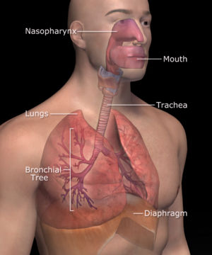
The Importance of the Respiratory System

Slide 2
Why do we need to breathe?

Slide 3
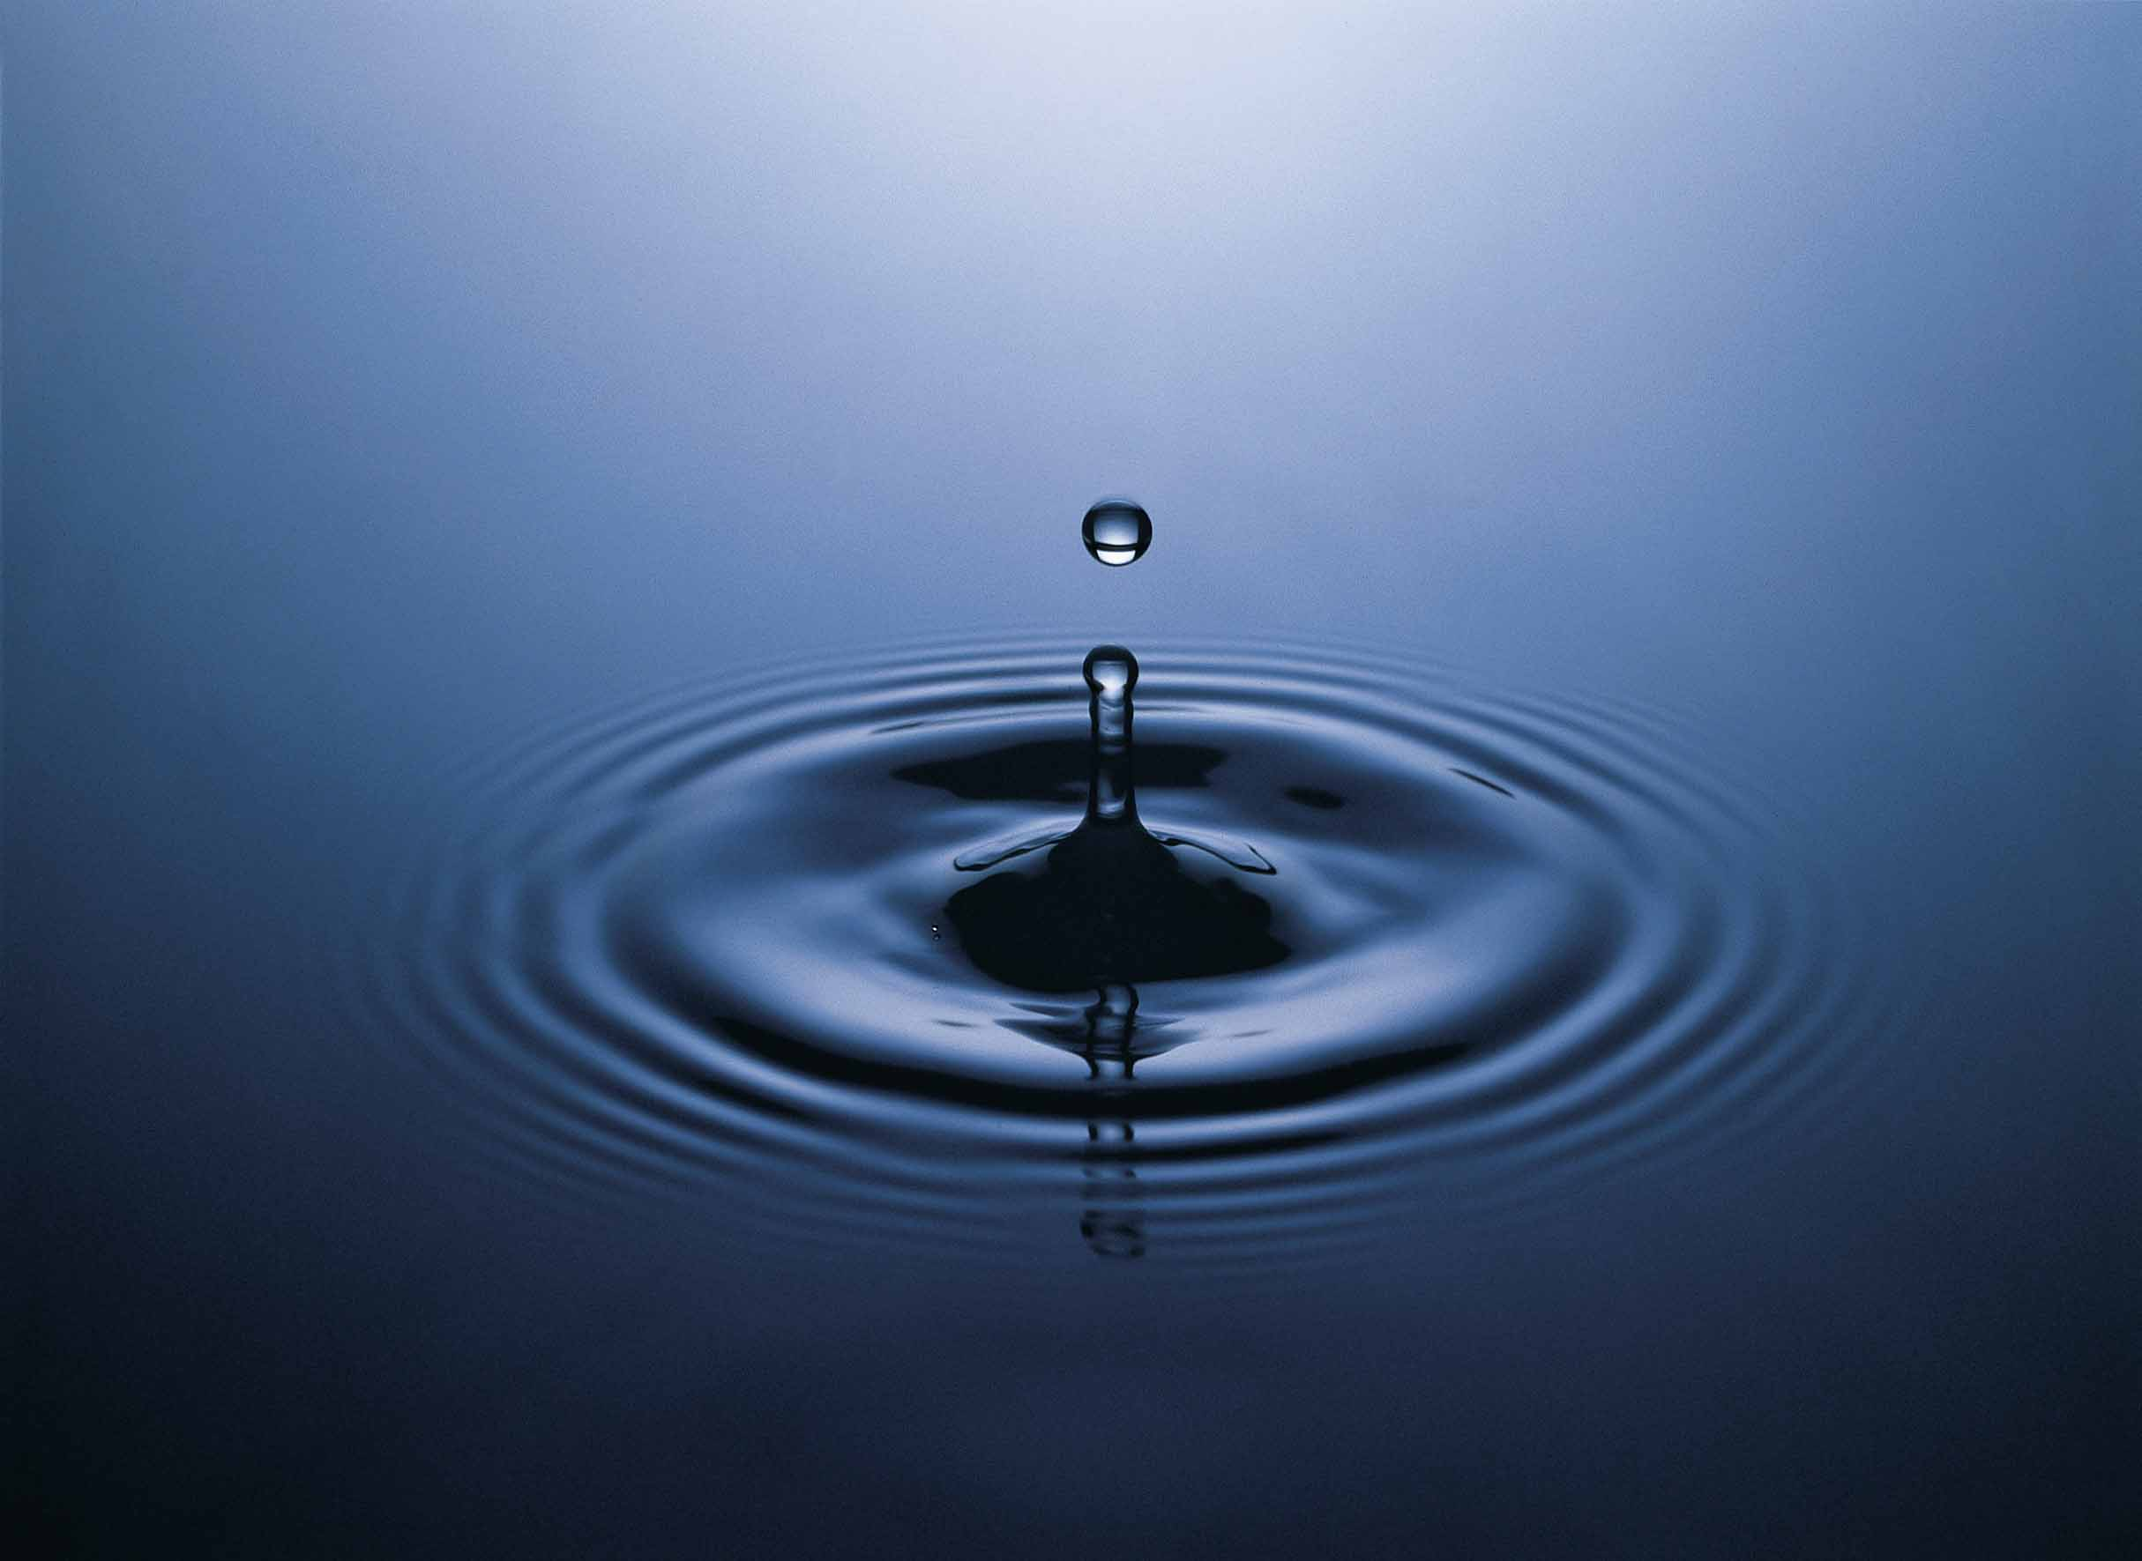

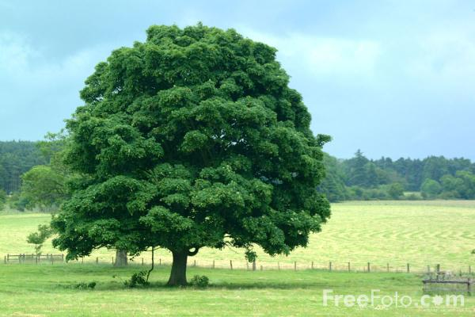
Oxygen is so essential to humans that they would die within a few minutes. We can survive a few days without water and weeks without food.

Slide 4
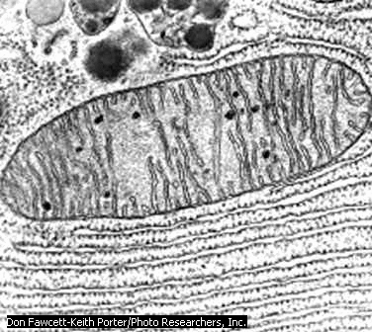
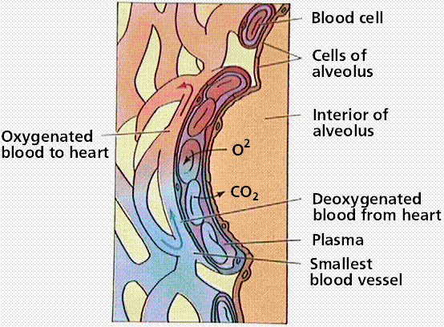
Respiration describes all processes involved in the exchange of oxygen and carbon dioxide between cells and the environment. Respiration includes breathing, gas exchange, and cellular respiration (in mitochondria).

Slide 5
Refresh me on cellular respiration?

Slide 6
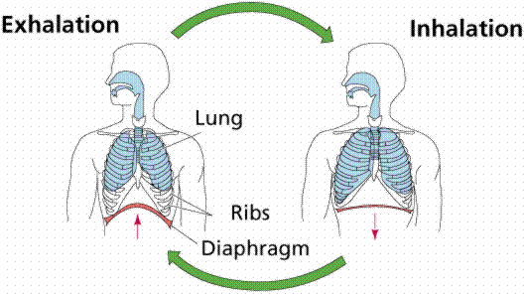
Breathing is the movement of gases between the respiratory membrane of living things and their external environment.
Respiratory Membrane is the membrane where the diffusion of gases occurs.

Slide 7
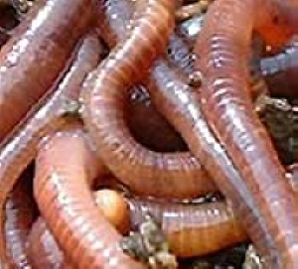
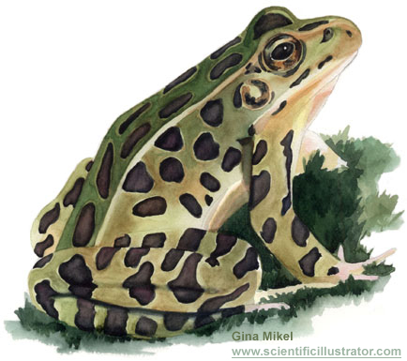
The Challenge of Getting Oxygen
The bigger you are the more oxygen you need!
The larger and complex organisms must have a large surface area to exchange the gas. Worms use their moist skin as the surface area to exchange gas. It must stay moist to work!
Frogs use both, skin and lungs…

Slide 8
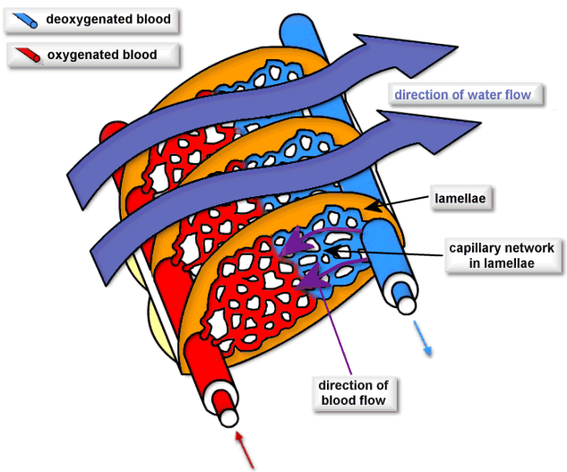
Other animals use gills for their exchange. Folding and branching of gills gives them increased surface area. Gills work great in aquatic situations and not in terrestrial situations. Air would dry them out too quick and the exchange could not occur. There always has to be a moist surface for this to occur.
Fish use a countercurrent flow. This has water moving in one direction and the blood in the opposite direction. This increases efficiency. An important point to note is that oxygen can only diffuse in a high to low direction! So, if the water has a lower concentration of oxygen than in the fish’s body the fish will die.

Slide 9
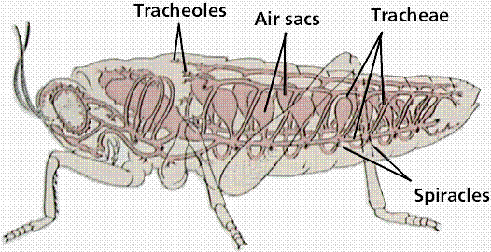
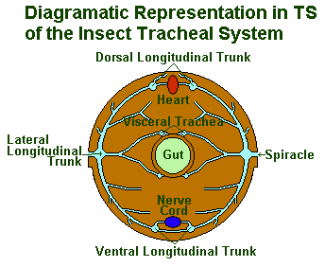
Insects use a tracheal system. This system consists of branching tubes, connecting cells directly to the atmosphere by openings in the exoskeleton called spiracles. This is great for small land animals, but not so great for larger animals.

Slide 10
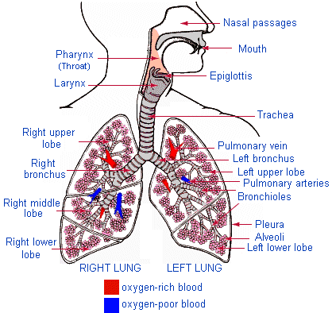
The air contains 20 times more oxygen than the water does. The larger land animals need a better way to secure their oxygen. So they use the lung, which is a system that consists of a wind pipe (trachea) that branch into the lungs. The lungs contain internal fold which increase the surface area and increasing the opportunity to absorb more oxygen.

Slide 11
